Slide 1


Smart Excavator Based on ADI Technology
Weng Zhe, Xu Jirui, Wan Shuo, Huang Lu
Tsinghua University
2016-4-25

Slide 2
Background
Why we are developing a smart excavator
Traditional excavator: ineffective, poor safety, lack of accurate measurement of weight
Tendency:unmanned, intelligent, interconnected, industry 4.0
What we do
To build a unmanned intelligent excavator based on ADI technology and LEGO’s toy excavator
To achieve functions of intelligent target recognition, autodig, weight measurement and foreign object detection
To realize high efficiency mining and ensure high safety
ADI Technology Involvement
Functional module: power supply, motion control, target detection & recognition, manipulator control, foreign object detection
For MicroController Unit, ADZS-BF707-BLIP2(or ADSP-BF54x/BF60x/BF70x), Because of it’s high computing performance
For module’s control, ADUC83x/ADUC84x/ADSP-CM40x, using several 51/ARM processors to control each module, stable & convenient
For Sensors, we choose EVAL-ADXRS290Z for Shedding, ADA4571BRZ for angle measurement, stable & high performance
Future
Add more excavators and trucks, to realize a system using communication
Take more factors into consideration, like traffic lights, roadblocks & safety control etc.

Slide 3




Team Member & Responsibilities
Leader
Huang Lu
Junior of EE, Major in Electronic Information
Be good at image processing & speech signal processing
Project management, Organized panel discussions, Visual processing & partial hardware implementation
Other Members
Xu Jirui
first grade Master in Mechanical Engineering
Be good at mechanical structure designing, kinetics analysis, mechanotronics, be skilled in cad/cam, solidworks, proe & labview etc
Responsible for manipulator control & vehicle structure improvement
Weng Zhe
Junior, Major in Microelectronics
Be skilled in hardware design, be good at programming
Responsible for hardware system design & partial implementation
Wan Shuo
Junior of EE, Major in Electronic Information
Be good at image processing & programming
Responsible for target detection and recognition & partial hardware implementation

Slide 4
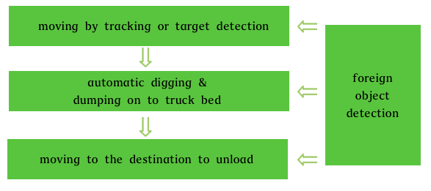
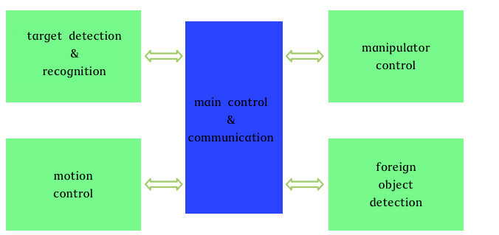
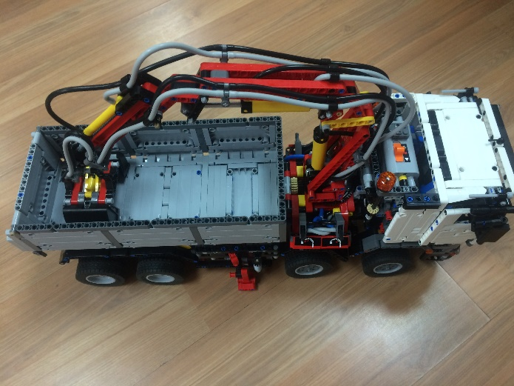
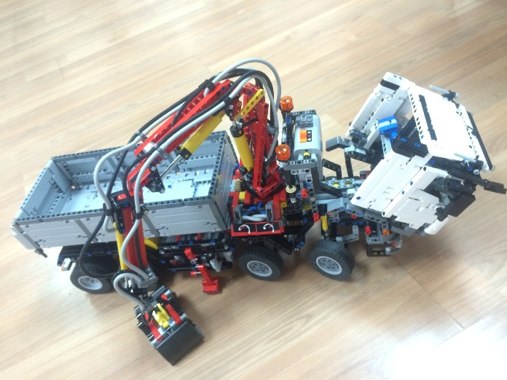
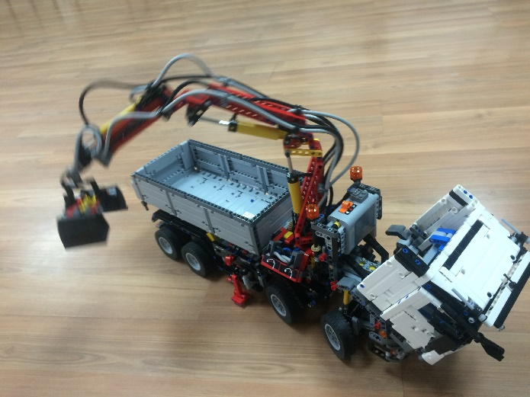
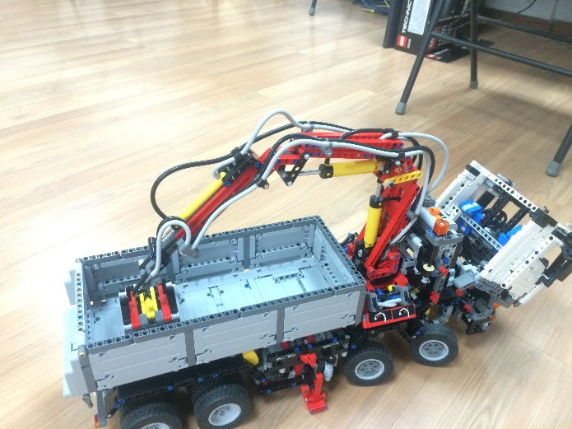
Diagram
Work Process
Function Model

Slide 5
System Architecture
③Vehicle motion control
IMU
Infrared
Inter-module communication
Master/
Target Recognition
Camera
⑤power source
motor feedback
MCU
ARM/51
STM32F4
/BF70x
Lithium
battery
motor driven
Ultrasonic
Regulator
vehicle posture solver
motor feedback processing
Ranging
Target Recognition
Image acquisition
Tracking
line
Motor speed control
decision-making
comments
Functions
④manipulator control
②foreign object detection
Hardware
Pressure detection
MCU
ARM/51
Ultrasonic
MCU
ARM/51
Rudder control
Software
connecting rod
Calculating pressure
Ranging
Feedback / output
Machine
Rudder
judgment
Posture control

Slide 6
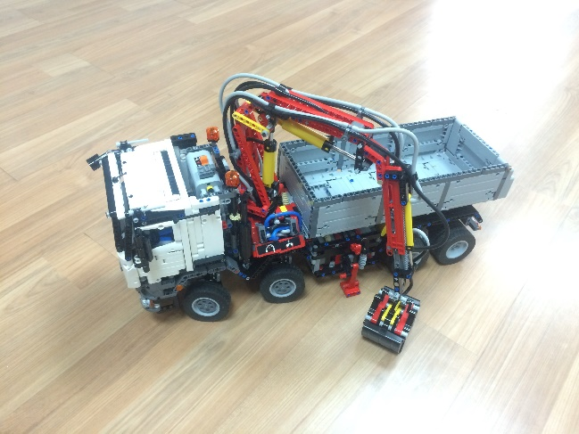
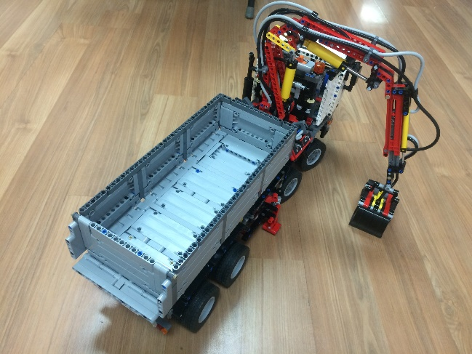
Stage
Stage I
Excavator goes to the target area by using infrared tracking
Function modules: motor driver, tracking, truck bed control
Schedule: 7/15
Stage II
Add camera, ultrasonic sensors, magnetic angle sensor & gyro
Function modules: ranging, motor control, obstacle avoidance
Schedule:8/25
Stage III
Modify the structure of the manipulator, realize manipulator control & automatic digging
Function modules: target detection & recognition, manipulator control
Schedule:10/1

Slide 7
Potential Problems
How to distinguish the target area and foreign object accurately?
How to improve the SNR for inter-module communication?
How to avoid the collision between manipulator the bucket?
How to measure the weight of the “soil” fetched by manipulator?

Slide 8
ADI Parts
Part Number | Qty. | Part Number | Qty.
ADZS-BF707-BLIP2 (or ADSP-BF54x/BF60x/BF70x) | 1 | ADP7105-3.3 | 1
ADUC83x/ADUC84x/ADSP-CM40x | 4 | AD8692 | As need
EVAL-ADXRS290Z | 1 | AD8694 | As need
ADA4571BRZ | 1 | OP07D | As need
ADUM7234 | 4 | AD7478A | As need
ADP505x | 2 | AD5621 | As need
ADP7105-5.0 | 1 | …

